Slide 1
Adaptive Invoice Processing
- (using fuzzy pattern matching)
Teragigs Team –
Bhavik Vora – 001615489
Charishma Seenappa – 001684861
Deepti Pundlik – 001677326
Juilee Jadhav – 001628927
Prarthana Angadi - 001619217
DBMS_Fall2015_TeamTeragigs

Slide 2
Overview
Problem Statement
Proposed Solution
Advantages
Assumptions
EER-Diagram
Special Feature
- Java Based XML parsing
- BI analytics using the tool Tableau.
DBMS_Fall2015_TeamTeragigs

Slide 3
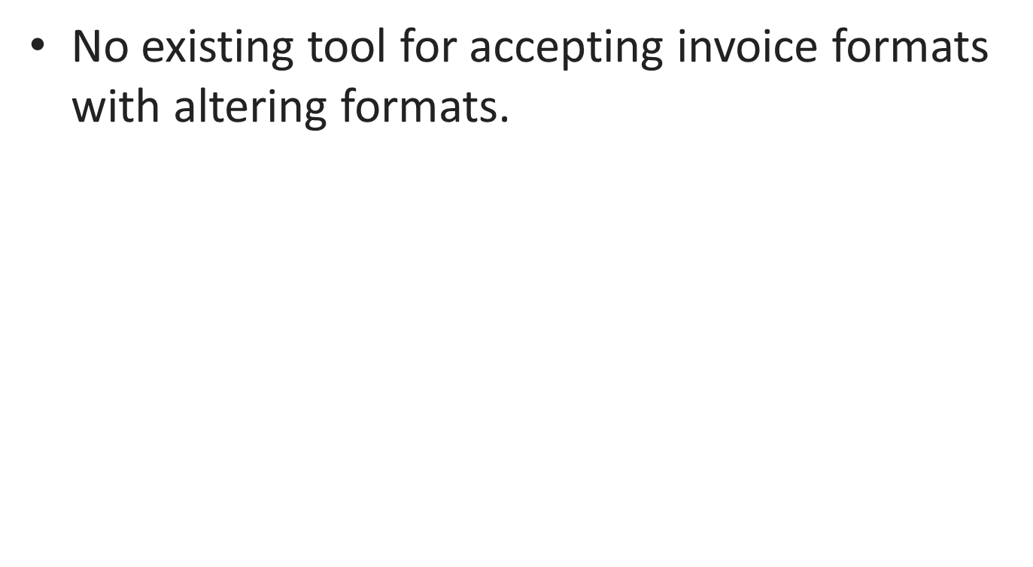
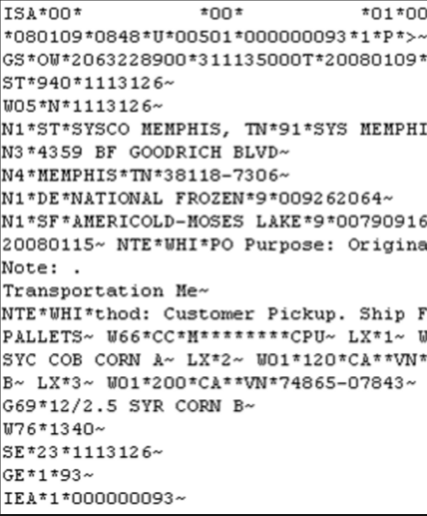
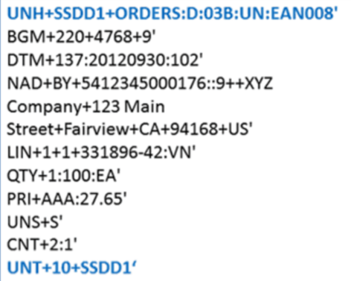
Problem Statement
DBMS_Fall2015_TeamTeragigs

Slide 4
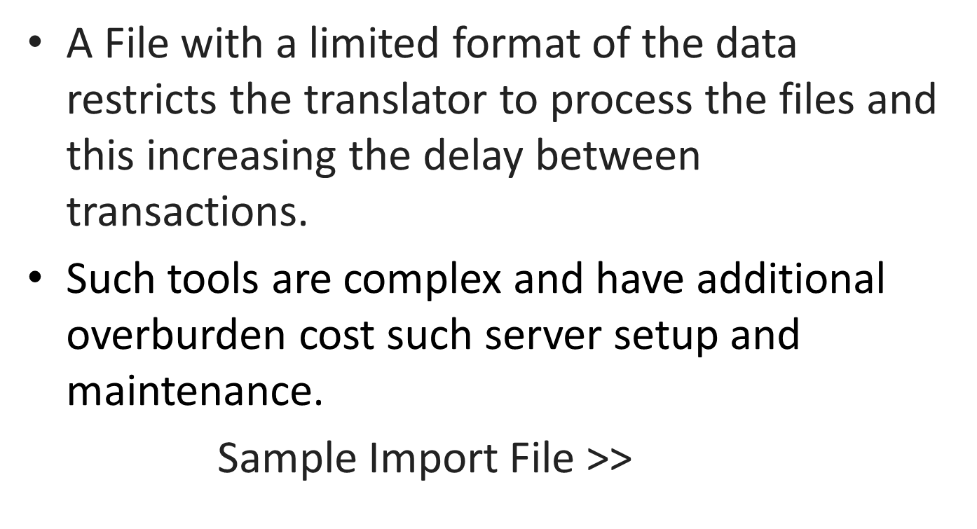

...continued
DBMS_Fall2015_TeamTeragigs

Slide 5
Proposed Solution
Collect different Invoice format files
Extract & store the data using fuzzy pattern matching
Database
Map and analyze the data
Retrieve the formatted data
DBMS_Fall2015_TeamTeragigs

Slide 6
Advantages
Advantages over existing B2B / EDI translators
No fixed file format needed
Reduces Overburden cost for setup and maintenance
Supports multiple tag formats and phonetic based processing - (Yes, you read it right !!)
DBMS_Fall2015_TeamTeragigs

Slide 7
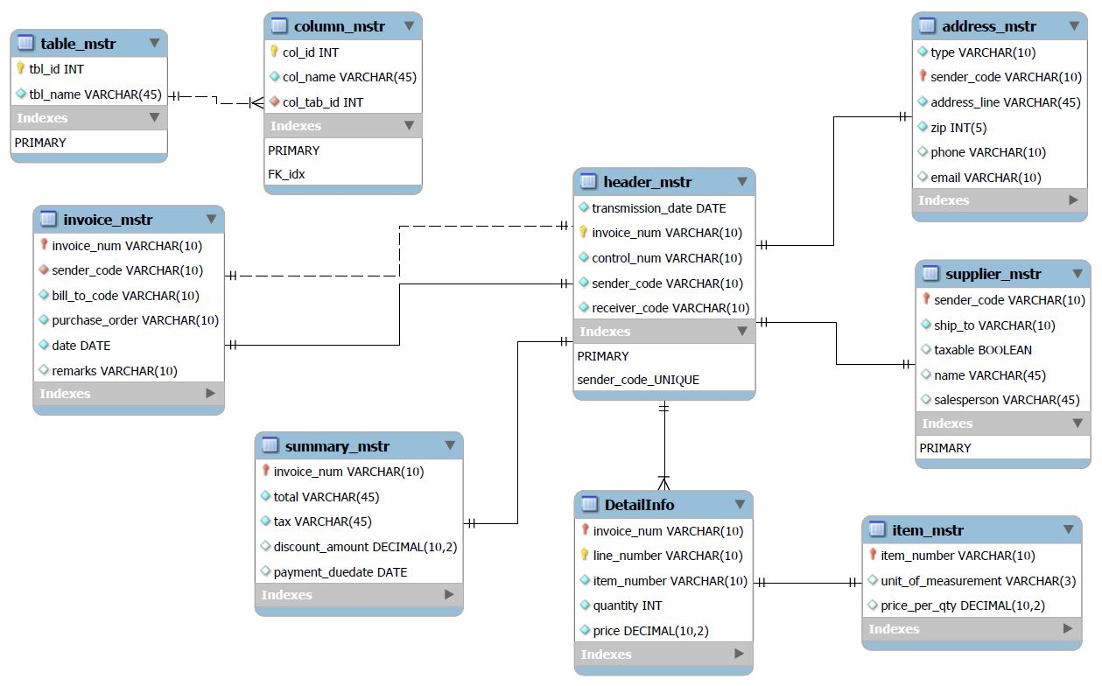
EER Diagram
DBMS_Fall2015_TeamTeragigs

Slide 8
Special Features
Pre-Processing in Java for storage of data
Pattern matching based on :
  Keyword
  Phonetic Algorithm
  BI Analytics using Tableau and Publish it on Web
View on Tableau Public >>
DBMS_Fall2015_TeamTeragigs

Slide 9
Project Components
Java Pre-Processing
XML Parsing
MySQL Integration
Stored Procedures
User Privileges
Database Backup Recovery
BI Integration Using Tableau.
DBMS_Fall2015_TeamTeragigs

Slide 10
Assumptions
Depth of an incoming XML file is set to 3
Header tag should always be the first child node of the XML file
Invoice Number tag should be the first child node of the header tag
DBMS_Fall2015_TeamTeragigs

Slide 11
Thank You
DBMS_Fall2015_TeamTeragigs

